Slide 1
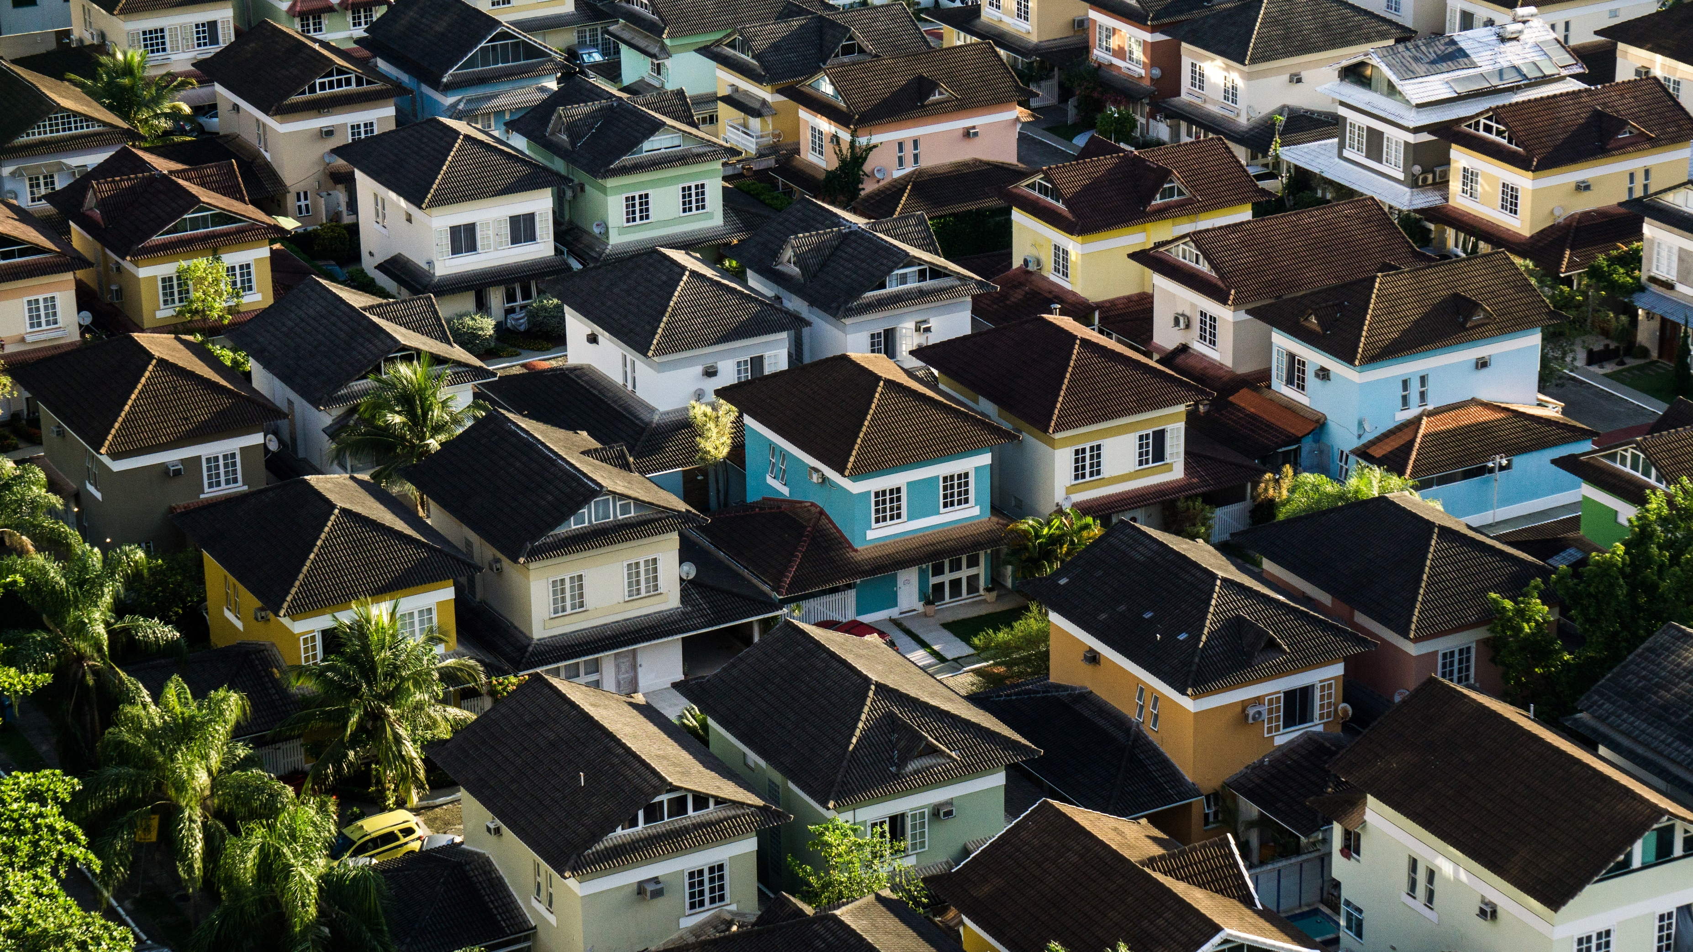
Ames Iowa Housing Price Prediction: What to buy & How to Sell
James Welch

Slide 2
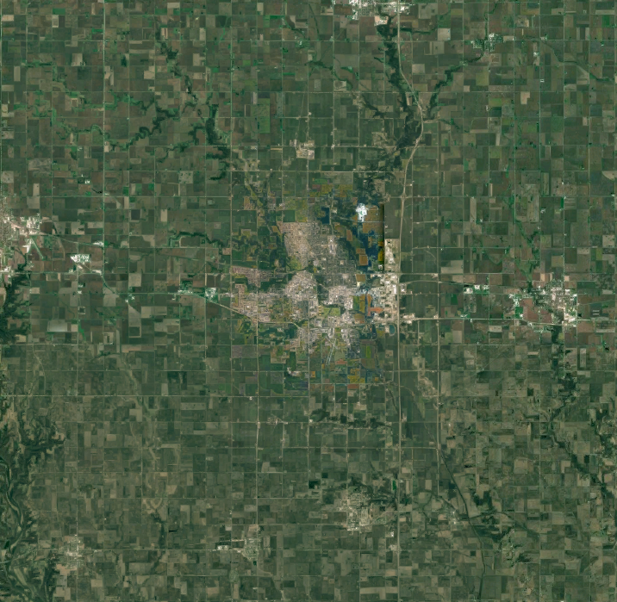
Ames Iowa
Modest Midwest City
Iowa State University
Housing Data
Notes:
Ames was founded in the 1860s and spent its early days as a stop along the transcontinental railroad.
This is a fairly small city at about 70,000 people and is surrounded by farmland, as you might expect in iowa.
Half the cities residents are students due to the presence of Iowa State university, Not to be confused with the buckeyes.
The university acts as an anchor for the community, boulsters the economy, and acts as a draw for other companies such as
3M (adhesives) and Ball (cans/jars)
Most importantly for us, Dean De Cock obtained and developed the Ames Housing Dataset. He aimed to create a resourse similar to the boston housing dataset and was able to obtain data from the city of Ames.

Slide 3
The Data
Land
House
Amenities
Lot Size, Neighborhood, Nearby Features
Baths, Square Footage, Basement, Garage
Pool, Fireplaces, Porches, Paved Driveway
Additional Information
Extra Features, Month & Year Sold, Sale Type & Condition

Slide 4




The Data
Land
House
Additional Features
Amenities

Slide 5
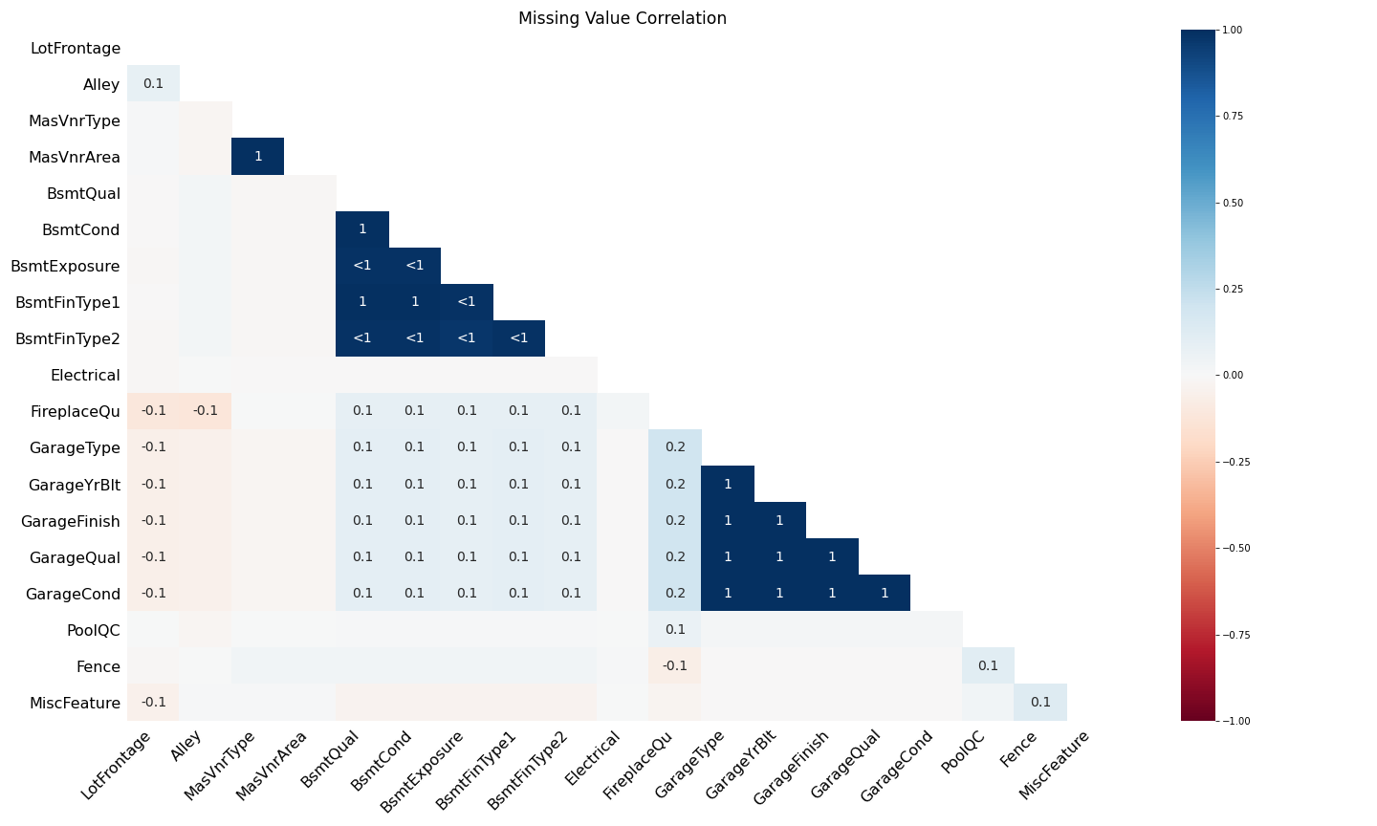
Missing* Values
Garage & Basement features so inter-group correlation
Other features show minor correlations.
However, we need to take the data key into account.

Slide 6
Actual Missing Values
Lot Frontage
N = 259
Masonry Veneer Type
N = 8
Electrical
N = 1
* Relative scale

Slide 7
Null Imputation & Data Cleaning
Electrical -> Mode
Lot Frontage -> Neighborhood x LotConfig or Neighborhood median
NAs -> “None” or 0
Some numbers are strings
Standardized ordinals
Exteriror2nd had several misspelled values (Brk Cmn -> BrkComm, CmentBd -> CemntBd, Wd Shng -> WdShing)

Slide 8
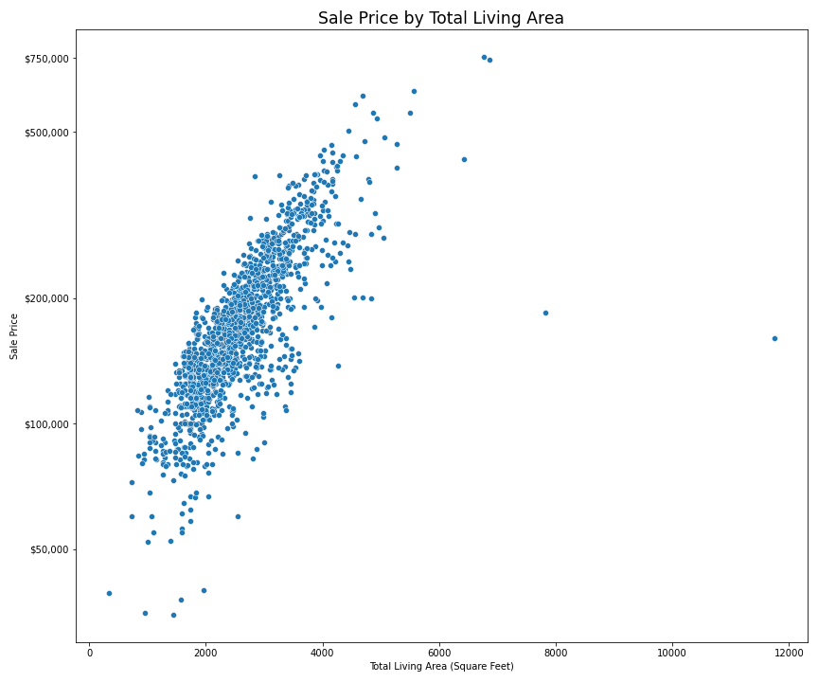
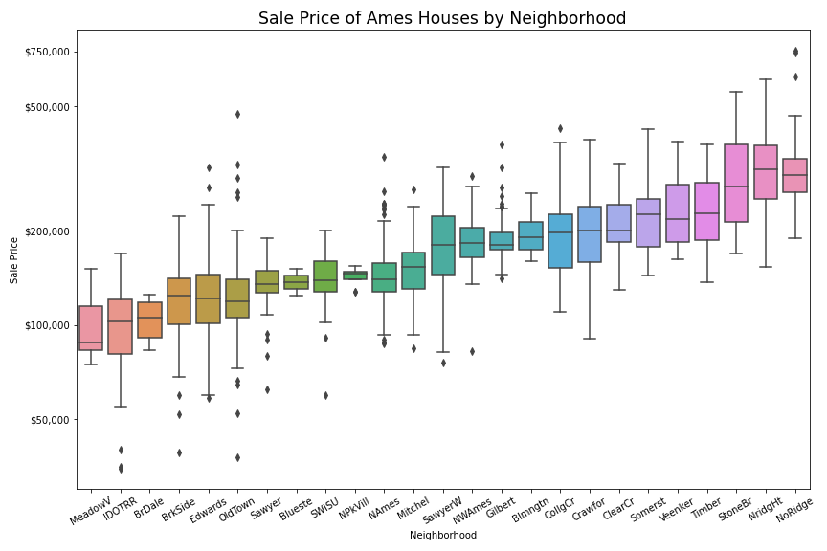
Some Features Contain Information

Slide 9
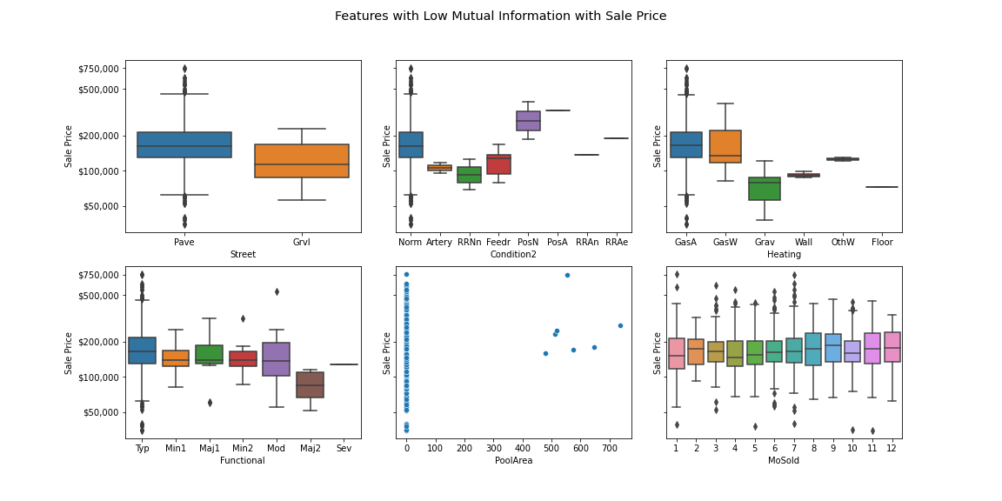
Others, less so

Slide 10
Feature Engineering
All porches were combined into PorchType & TotalPorchSF.
The finishes of the basement was pivoted.
Summarized some SF numbers,
- TotalSF,
- Floors
- Percent finished, baths/total Baths
Boolean
- Has Pool, Remodeled, recent taste,
Calculated YardSF as LotArea minus the house footprint, garage, pool and porches.

Slide 11
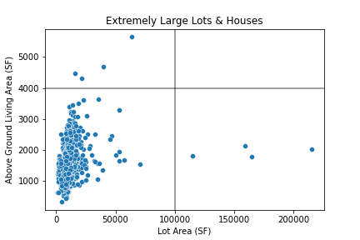
Outliers
The curator of the dataset suggests removal of houses with a GrLivArea greater than 4000.
LotArea also contains several outliers with z-scroes greater than 4.
Only one sale didn’t have standard Utilities
2.3 acres
Notes:
Original Paper suggests removing points with a Above Ground Living Area greater than 4000, which we saw before.

Slide 12
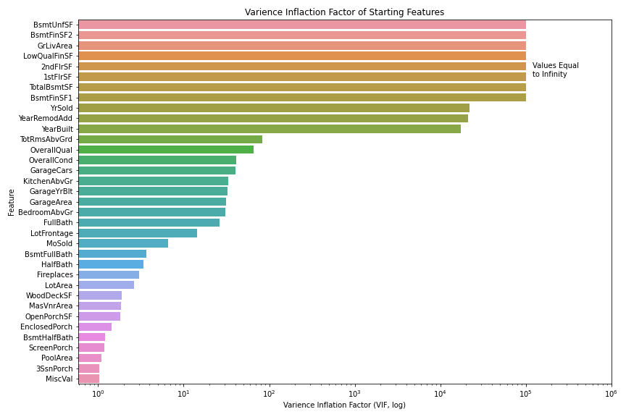
Multi-collinearity*
*Ugh, rules
Only numeric,
Rerun with tree prepped data?

Slide 13
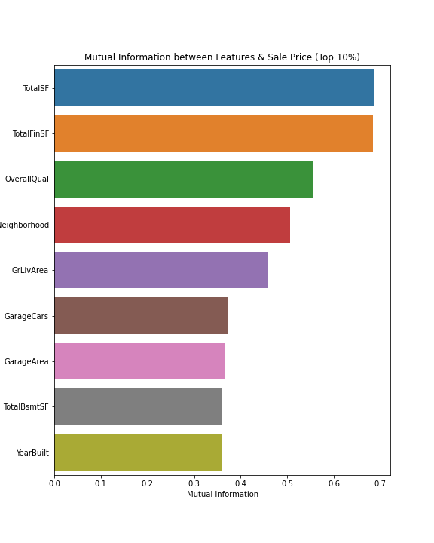
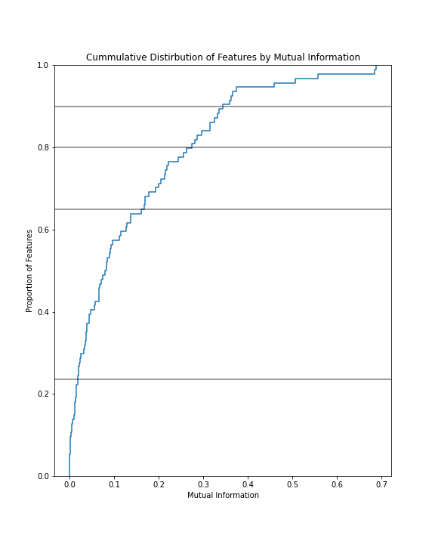
Feature Selection via Mutual Information

Slide 14
So Far
Feature Selection
Model Training
Multi-Collinearity
Outlier Removal
Imputation & Cleaning
Feature Engineering

Slide 15
Model Training Real flowchart?
Hyperparameters
Training / CV
GridSearchCV
Kaggle Training Data set
Data processing
Train-Test Split
Best Model + HPs
Validation
Validation Score
Cross-Validation Score

Slide 16
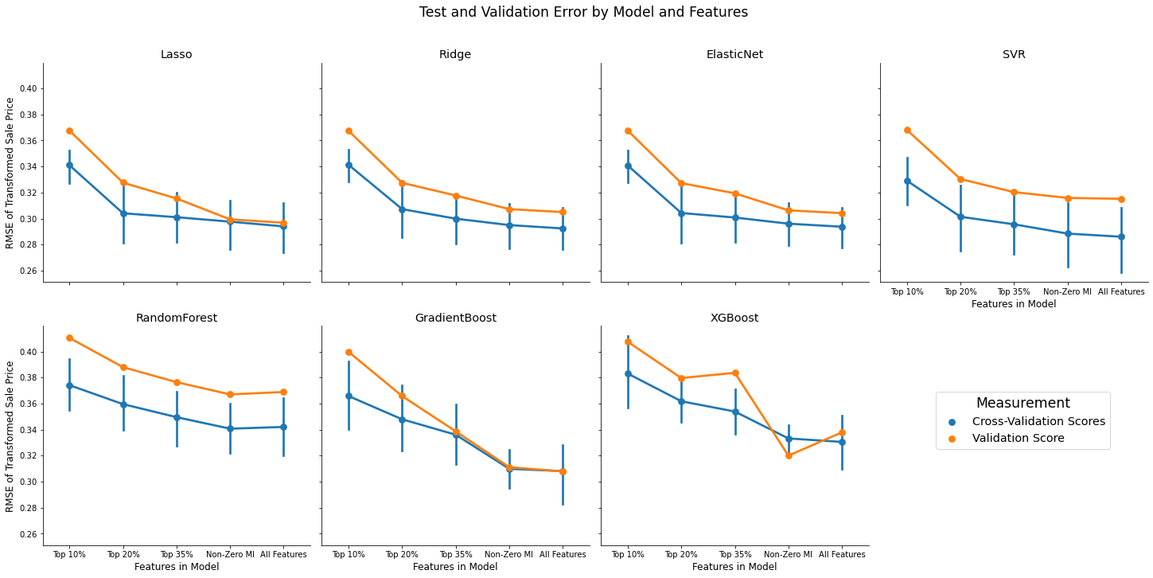
RMSE improves with More Features

Slide 17
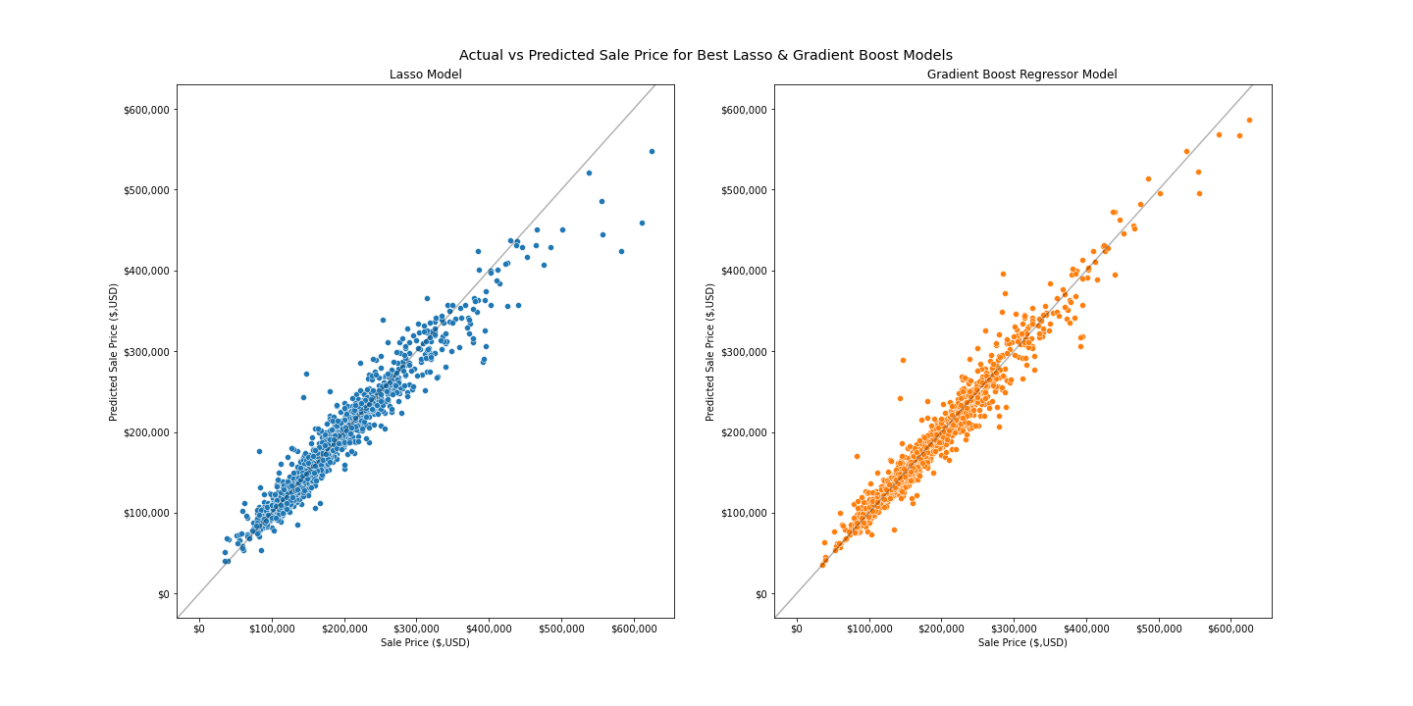
Models Poorly Predict Expensive Homes
Training Data:
Lasso: $18,700
Gradient Boost: $11,400
Validation Data:
Lasso: $19,300
Gradient Boost: $21,300
Kaggle Score:
Lasso : 0.21
Gradient Boost: 0.13

Slide 18
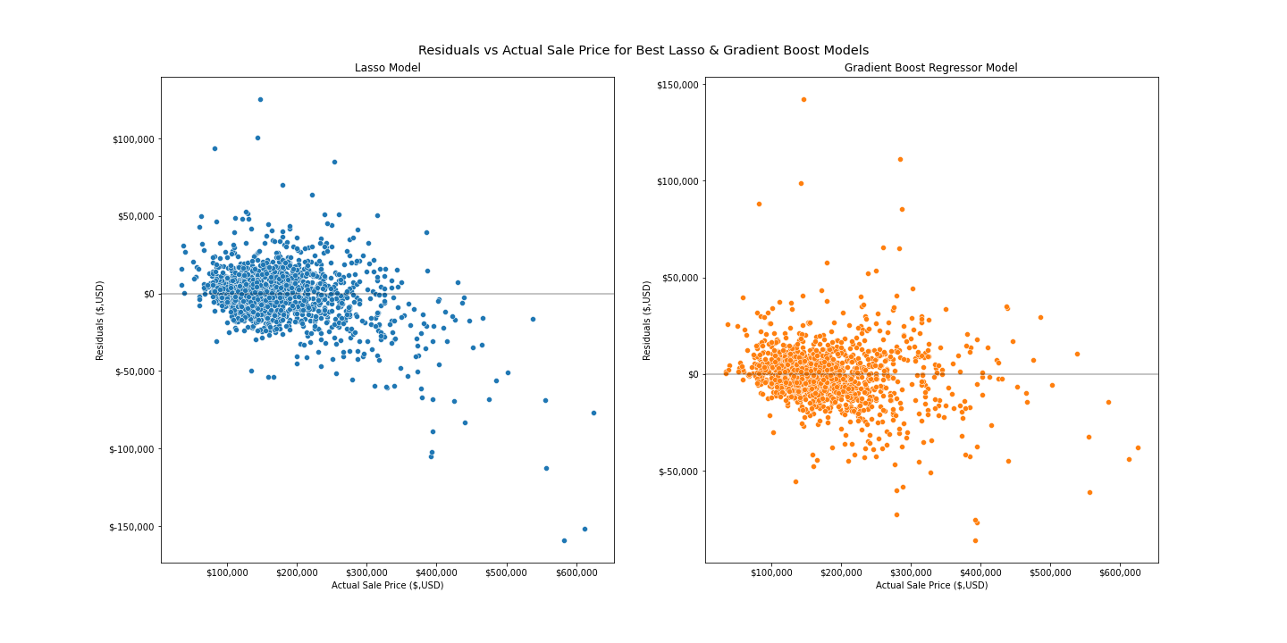
Model Residuals

Slide 19
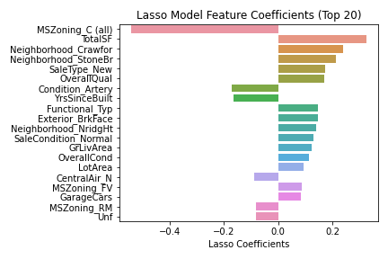
Lasso Important Features
Graphic of feature importance

Slide 20
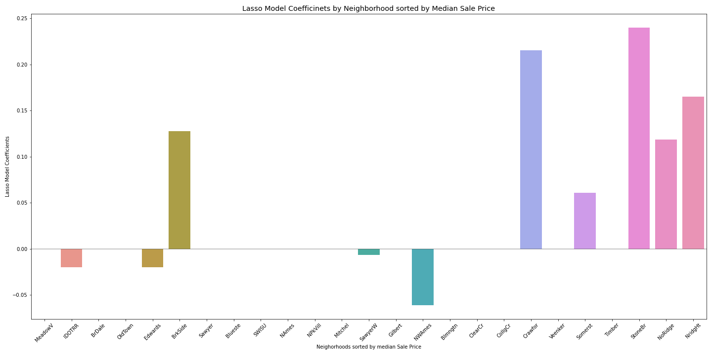
Neighborhoods

Slide 21
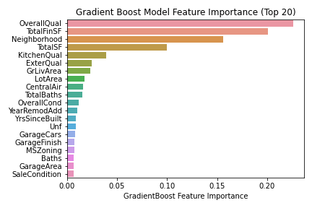
Gradient Boost Important Features

Slide 22
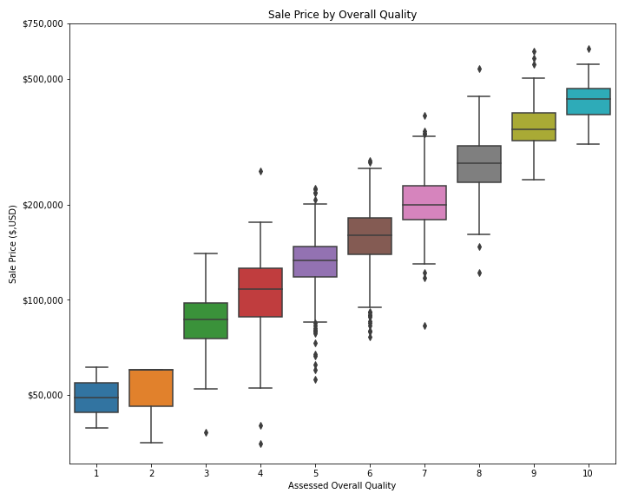
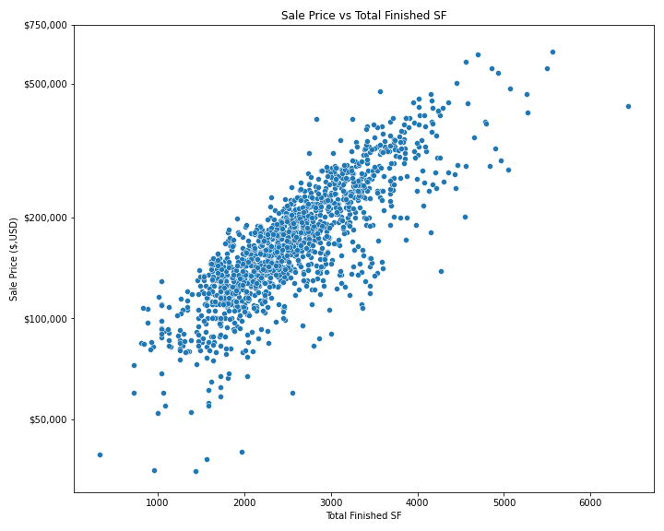
Quality
Total Finished SF = Total SF – Low Quality SF

Slide 23
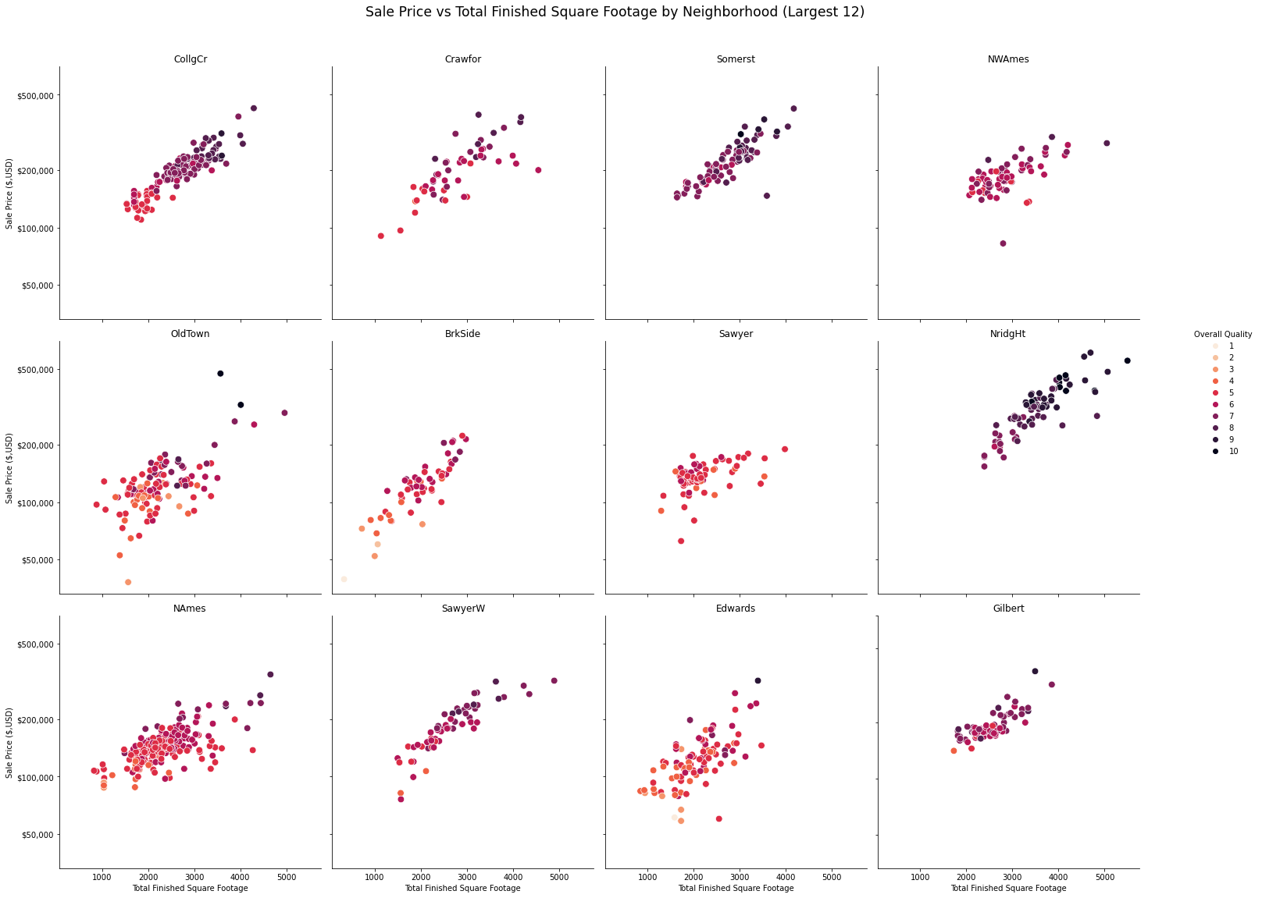
tyhinhg

Slide 24
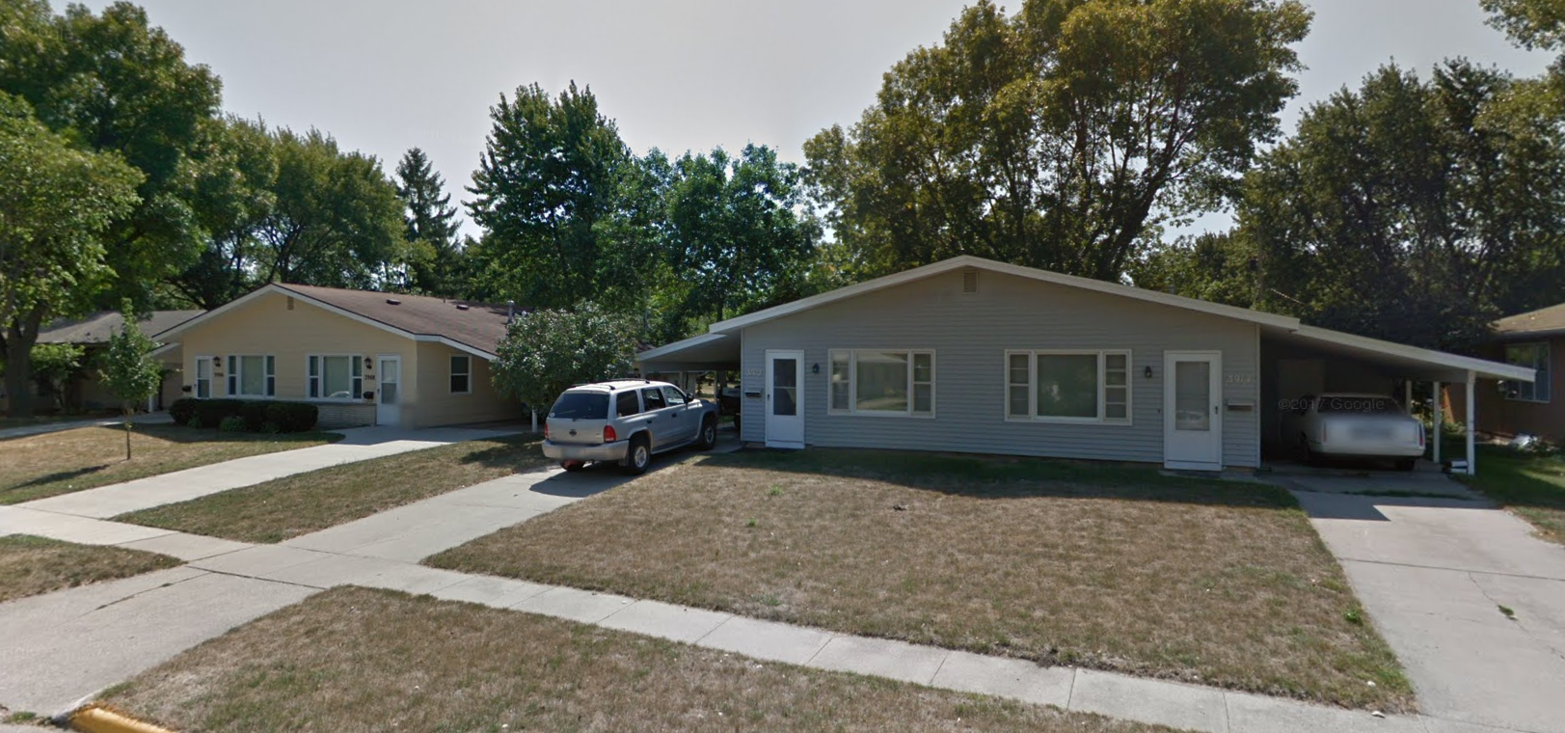
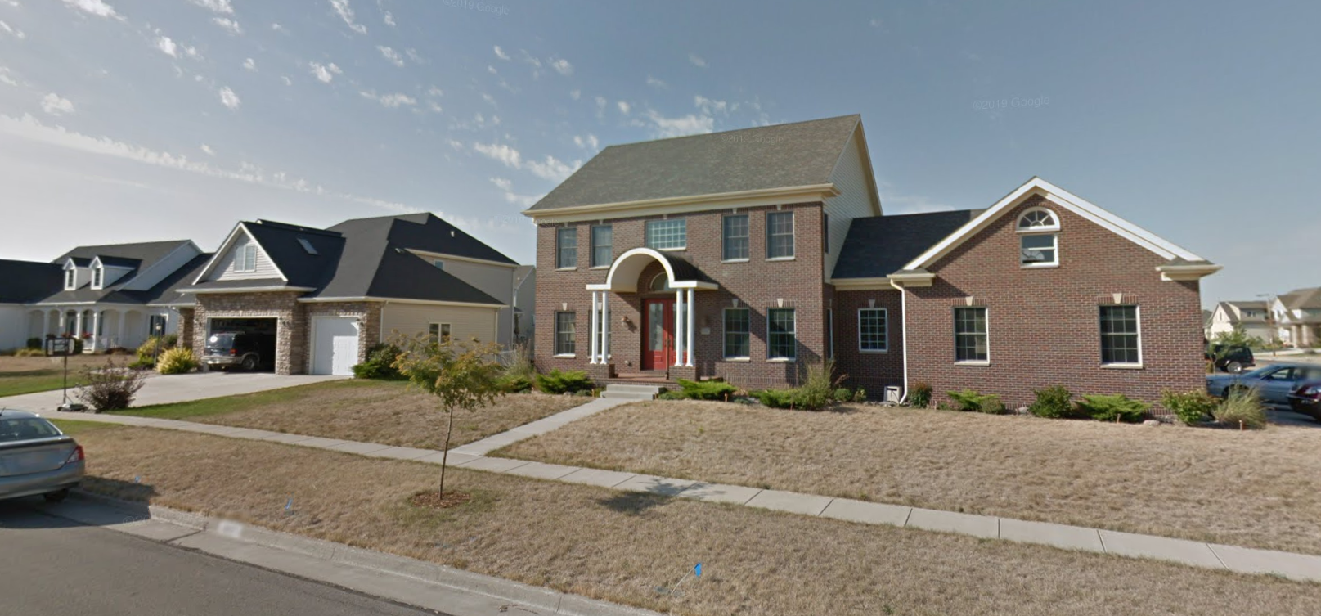
tyhinhg
Sawyer
NorthRidge Heights
Sawyer
Northridge heights

Slide 25
What does this mean for your house
Analysis?
- show the important features and what that means
#Interpretation, what values are large? Convert to dollars?
# What might be worth modifying
# what might be worth considering before buying
# Relative worth?
# Overall Qual & Finished SF

Slide 26
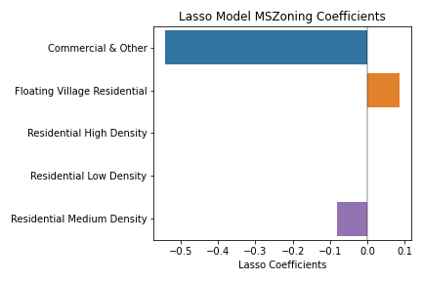
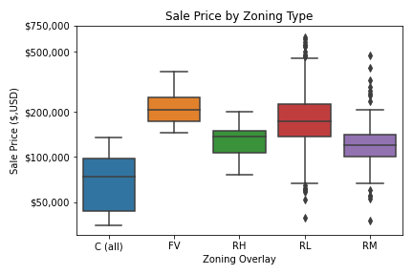
Zoning

Slide 27
Choosing your Home
Some important features can be manipulated include Overall & Exterior Quality & Condition, the quality of the kitchen and Finished or Livable Square Feed. All increasing the sale value of the home.
Ultimately, features like Neighborhood, and Lot Area
Total SF, Neighborhood, LotArea,
Before buying, consider the Zoning and Neighborhood. Especially if rules prevent you from upgrading your home to your liking.

Slide 28
Take Away’s
Purchasing:
Total Square Feet (Especially Finished)
LotArea
Zoning
Garage
Selling:
Overall Quality & Condition
Kitchen Quality
Central Air
Recent Remodeling
Seemingly Unimportant
Roofing Materials
Lot Shape
Paved Streets
Building Type
Fence
Number of floors
Neighborhood

Slide 29
Next Steps
Land & House
Process
Better Model
Notes:
Better feature engingeering

Slide 30
Conclusion
We can predict your value this well
These are the best ways to improve you house
This is what you should consider when buying a new one
What can we say about a new house?
Is it better to buy the best home in a bad neighborhood or the worst in a good one?
Cover Photo by Breno Assis on Unsplash

